Slide 2
Functional Programming for Object-Oriented Developers
Matthew O. Smith
Lambda Lounge
June 10, 2014

Slide 3
Overview
Who am I
State and Value
Pure Functions
Immutability
Lambda
Unlearn what you have learned

Slide 4
Who am I ?
CS from the U of U
Accidental Author – Ferocious Flirting: Making Marriage Wonderful
Java Programmer since before Swing
Functional Programmer even longer
Supervisor of Software Engineers at Intermountain Healthcare

Slide 5
State and Value
Value – fixed over time
State – varies over time

Slide 6
Examples of State and Value
5
int x = 5
final int x = 5
new Long(5)
Long y = new Long(5)
final Long y=new Long(5)
new Date(1)
d = new Date(1)
final d = new Date(1)
What color should “d” be?

Slide 7
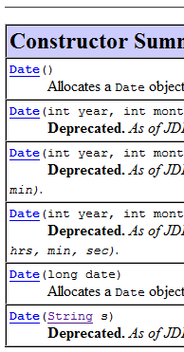
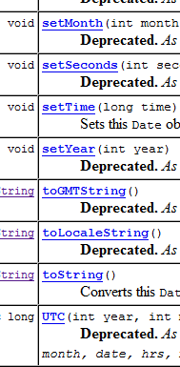
Date is the poster child for a state that should be a value
java.util.Date

Slide 8
State is everywhere
Date
beans
Collections
Arrays

Slide 9
Ways to use minimize state
Create immutable objects
Use Factories and Builders
Talk to abstractions
It is a conscious decision and work in Java

Slide 10
Comparable vs HashMap keys
http://docs.oracle.com/javase/7/docs/api/java/lang/Comparable.html
http://howtodoinjava.com/2013/05/02/how-to-design-a-good-key-for-hashmap/

Slide 11
Immutable is hard
http://codereview.stackexchange.com/questions/66629/immutable-objects-in-java

Slide 12
Using state and values
Minimize and localize state
Centralize state – every object needs a value, not state
Localize state – keep state in a method, do not let it escape
Façade pattern – make a state look like a value – it is only state if it actually changes
Favor pure functions

Slide 13
Pure Functions
Thinks “math functions”
Functions vs methods
Treating all inputs and outputs as values
Separate data from functions

Slide 14
Think Math Functions
f(x) = x * x
Inputs are values – output is a value
No side effects
No state change
arguments unaffected - collections
calling with the same arguments yields the same results
Seriously, all this is really useful.

Slide 15
Functions Vs Methods
Difference between functions and methods
Dynamic dispatch
Implied “this”
Does not matter in the least – I am going to call them functions

Slide 16
Treating all inputs/outputs as values
Best to actually pass values
Code to interfaces
Never alter an input
Decorator pattern
Visitor/Iterator pattern
Return values where possible

Slide 17
Separate data from functions
Forget “Objects should know how to … for themselves”
Use Strategy pattern to define algorithms outside the values they work on

Slide 18
For loops and state Iterators do not help
int sum = 0;
for(int i = 0; i < 10 ; ++i) {
if(i % 2 == 0) sum += i;
}

Slide 19
Lambdas and Streams
Find the names of albums that have at least one track rated four or higher, sorted by name, without state.
List<Album> sortedFavs = albums
.stream ()
.filter ( a->a.tracks
.stream()
.anyMatch(t-> (t.rating >= 4 )))
.sorted (Comparator.comparing( a-> a.name))
.collect (Collectors.toList());
Notes:
See https://github.com/mperry/talk-java-lambdas/blob/master/Are-Lambdas-Great-in-Java-8.pdf

Slide 20
Demo – FunctionalDate
Value
predicates – before, after – code to interface Comparable
Could be reused with all Comparables
giving meaning - calendar – parse, format – strategy: value => value
Gregorian, Chinese, Hebrew, etc

Slide 21
The End
Design Patterns – Gang of Four Book
https://github.com/mperry/talk-java-lambdas/blob/master/Are-Lambdas-Great-in-Java-8.pdf
http://www.lispcast.com/java-learn-from-clojure
https://github.com/m0smith/presentations/tree/master/FunctionalProgrammingForJavaDevelopers

